Slide 1

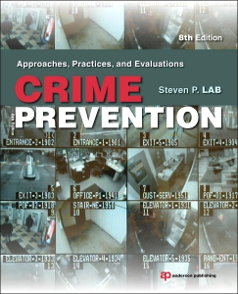
Chapter 6
DISPLACEMENT AND DIFFUSION

Slide 2
Introduction
The fact that most prevention programs are place- specific means that evaluations typically focus only on changes within the target neighborhood or community
Crime prevention programs could have an impact beyond that which is intended
Changes could be either positive or negative
Evaluations generally fail to consider the possibility of either displacement or diffusion

Slide 3
CRIME DISPLACEMENT
Represents change in crime due to the preventive actions of the individual or society
Assumption is that many crime prevention actions simply move the crime around
Can take forms other than just the geographical movement of crime
Reppetto (1976) offers five forms of displacement
  (1) territorial, (2) temporal, (3) tactical, (4) target,
  and (5) functional
Barr and Pease (1990) offer perpetrator displacement

Slide 4
TERRITORIAL — | movement of crime from one area to another, typically contiguous, area
Example — | a neighborhood watch program is started and the burglars move to another neighborhood
TEMPORAL — | a shift in offending from one time to a different time, such as from day to night
Example — | a citizen patrol is instituted at night, thus prompting burglars to work during the morning hours
TACTICAL— | changing the methods used in the commission of a crime
Example — | the installation of deadbolt locks on doors results in burglars forcing open windows to gain entry
TARGET — | choosing a different victim within the same area
Example — | a neighborhood watch program is started but only half the homes participate, thereby leading offenders to target non-participating homes
FUNCTIONAL — | the offender stops committing one offense and shifts to another
Example — | when burglary becomes more difficult due to target-hardening devices, the offender decides to commit robbery instead
PERPETRATOR — | one offender ceases activity only to be replaced by another offender
Example — | while crime prevention actions cause an individual to desist from further offending, another individual sees opportunities and begins offending

Slide 5
CRIME DISPLACEMENT
ASSUMPTIONS
Crime is inelastic
  driven to commit a certain number of offenses over a given period of time
Offenders have mobility
  can be across time, place, tactic, or any displacement dimension
  not all potential offenders, however, have the same level of mobility
    youths may not have access to transportation or they may be tied to school and curfews

Slide 6
CRIME DISPLACEMENT
ASSUMPTIONS
  may be limited by features of the surrounding environment
    isolated by location or physical barriers (see next slide)
Offenders make rational choices
  based on various factors in the physical and social environment
  respond to payoff, effort, peer support, risks, and similar factors in making decisions
Alternative targets and choices are available

Slide 7
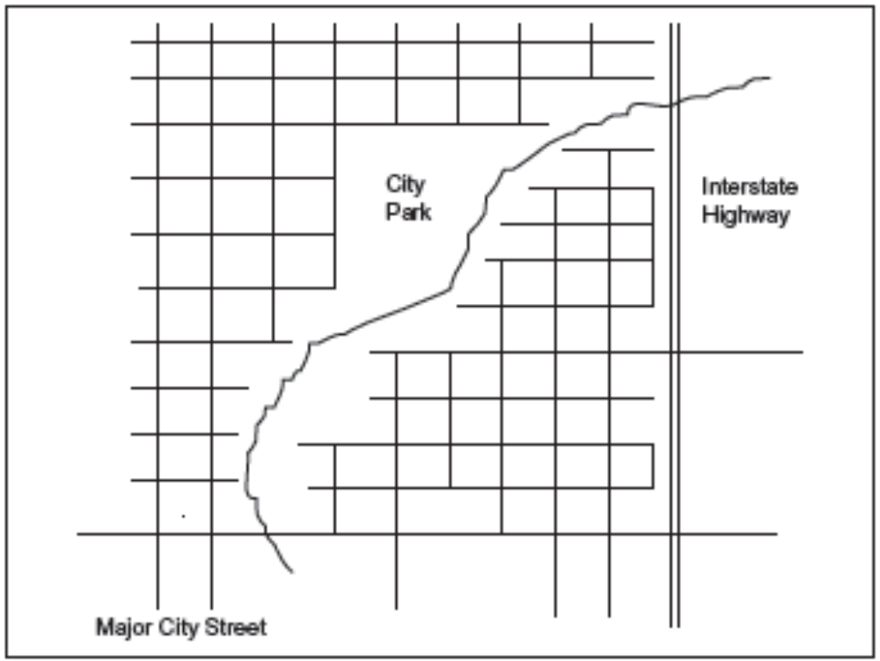
Example of a City with a Geographically Bounded Neighborhood

Slide 8
CRIME DISPLACEMENT
DISPLACEMENT: BENIGN OR MALIGN?
Displacement can be positive
Malign displacement leads to undesirable outcomes
  E.g., efforts aimed at reducing burglary may prompt an increase in robberies and accompanying levels of assault
Benign displacement suggests that changes from displacement may benefit society
  E.g., new crime or tactics that are utilized by offenders may be less serious and offer less danger to the potential victims
Certain areas or neighborhoods become crime fuses
  area where crime is allowed to operate without bothering the rest of society until it explodes in the area

Slide 9
DIFFUSION OF BENEFITS
Clarke and Weisburd (1994, p. 169):
  the spread of the beneficial influence of an intervention beyond the places which are directly targeted, the individuals who are the subject of control, the crimes which are the focus of intervention or the time periods in which an intervention is brought
assumes that prevention efforts will benefit people and places other than those targeted
variety of names, including “halo effect” and “free bonus effect”

Slide 10
DIFFUSION OF BENEFITS
Two potential sources for diffusion:
  deterrence
  discouragement
    reducing the payoff and increasing the effort needed to commit a crime

Slide 11
OFFENDER CHOICE AND MOBILITY
Opportunity is the cornerstone for all criminal behavior
Felson and Clarke (1998)—“Individual behavior is a product of an interaction between the person and the setting”
Three primary theoretical orientations:
(1) Routine Activities, (2) Rational Choice, and
(3) Crime Pattern Theory
10 principles of opportunity
  deal with the variation in opportunities across time, space, and circumstances
  suggest that reductions in opportunity can reduce crime, with little displacement

Slide 12
Ten Principles of Opportunity and Crime
1. | Opportunities play a role in causing all crime.
2. | Crime opportunities are highly specific.
3. | Crime opportunities are concentrated in time and place.
4. | Crime opportunities depend on everyday movements.
5. | One crime produces opportunities for another.
6. | Some products offer more tempting crime opportunities.
7. | Social and technological changes produce new crime opportunities.
8. | Opportunities for crime can be reduced.
9. | Reducing opportunities does not usually displace crime.
10. | Focused opportunity reduction can produce wider declines in crime.

Slide 13
ROUTINE ACTIVITIES
Argues that the normal movement and activities
of both potential offenders and victims plays a role
in the occurrence of crime
Three criteria that must exist for crime to occur:
  (1) a suitable target
  (2) a motivated offender
  (3) an absence of guardians
Factors have changed over the years

Slide 14
ROUTINE ACTIVITIES
Increased availability of suitable targets for crime
Risk of a target is directly related to Clarke’s (1999) discussion of hot products
These products are CRAVED
  C oncealable − ability of thief to hide items during the crime
  R emovable − size and weight make some items more portable than others
  A vailable − the item must exist and be available to be stolen
  V aluable − items that hold more value will be targeted
  E njoyable − the items must bring enjoyment to the offender
  D isposable − there must be a market for the stolen items

Slide 15
ROUTINE ACTIVITIES
The extent to which a target meets the CRAVED criteria will have an impact on the chances of an offense occurring

Slide 16
RATIONAL CHOICE
Offenders make rational choices about when and where to offend
Research on burglary presents a good illustration of how criminals make choices
  burglars note a variety of factors that they consider in their offense planning
  factors include the amount of cover available, the level of illumination, the types of locks, doors, and windows, the existence of alarms, and the possibility of being observed by neighbors and pedestrians

Slide 17
RATIONAL CHOICE
Quick, uninformed decisions, in reality, are rational choices based on prior experience and general knowledge
Various studies produce a portrait of offenders as rational decisionmakers who base many of their actions on the costs and benefits they perceive in the contemplated activity
  research suggests that offenders do not necessarily construct detailed plans for each and every offense
  rational choices and preconceived plans may be set into motion when the offender happens upon a situation or target that fits the general description of an appropriate target

Slide 18
CRIME PATTERN THEORY
Proposes that crime and criminal behavior fits patterns that can be identified and understood when viewed in terms of where and when they occur
Keys to understanding patterns
Environmental backcloth—the social, economic, cultural, and physical conditions within which people operate
Social/crime template—outlines expectations of what will happen at certain times and places, given certain behavior by the individual

Slide 19
CRIME PATTERN THEORY
Daily activity of individuals is one source of information used in learning the environmental backcloth and the templates
Individuals construct mental images or cognitive maps of the environment as they move about the community

Slide 20
CRIME PATTERN THEORY
Four factors that are needed to construct and maintain a mental image of an area
  Recognition refers to being able to identify your location and various features in the area
  Prediction involves making connections between the identifiable objects in the area and possible lines of behavior
  Evaluation uses the information gathered in the earlier stages and determines which options are acceptable modes of behavior
  Action
Cognitive mapping entails the removal of fear and uncertainty for the individual, which allows him/her to make an informed choice

Slide 21
CRIME PATTERN THEORY
Logical question flowing from the idea of cognitive mapping is how an individual gains recognition of different areas
Offenders form cognitive maps through normal daily activity that take an individual into and around various areas
  Build their knowledge as they go to and from work, do their shopping, socialize with others, go to school, or undertake any other daily routine behaviors

Slide 22
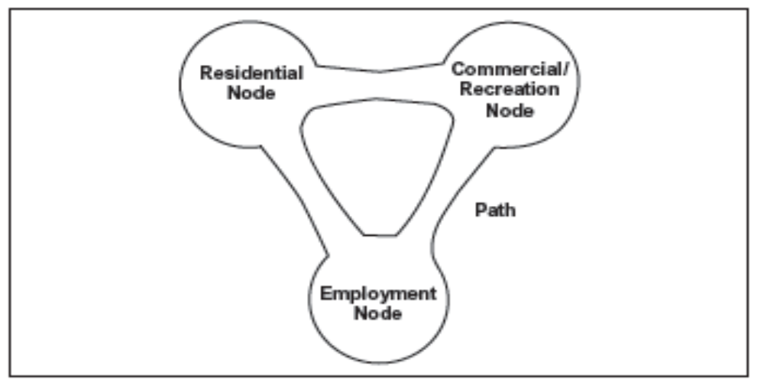
CRIME PATTERN THEORY
Continued growth and sprawl of modern urban communities greatly contributes to the building of larger and more complex cognitive map

Slide 23
CRIME PATTERN THEORY
Locations can be considered nodes of activity
Transit routes between the nodes are referred to as paths
Extent to which an individual utilizes each node and takes various routes (paths) between the nodes helps develop the cognitive map
Edges of the areas are prime spots for deviant behavior
  Physical edges may limit movement
  Social and economic edges reflect areas of potential offending due to anonymity

Slide 24
CRIME PATTERN THEORY
Nodes can serve to promote crime
  crime generators—by drawing potential victims to the area
  crime attractors—areas to which potential offenders and others are drawn, such as drug markets, sites of street prostitution, and/or adult clubs and bars
  hunting ground—offenders recognize that potential victims frequent an area, there is a lack guardians at that location and, consequently, the offender follows the victims to that place

Slide 25
EVIDENCE OF DISPLACEMENT
Little reason to ever expect total displacement of crime
TERRITORIAL DISPLACEMENT
Most common form considered in evaluations
Distance traveled can be measured in two ways
  Euclidean distance measures in a straight line from the start to the end point
    ignores the fact that physical features (such as buildings, rivers, and highways) make such travel impossible
  Manhattan distance measures distance as people follow roadways, generally selecting those that reduce both distance and travel time

Slide 26
EVIDENCE OF DISPLACEMENT
TERRITORIAL
There is a pattern of distance decay
  means that the commission of crime decreases as the distance from the offender’s home increases
Several studies claim evidence of territorial displacement
Not all research finds territorial displacement
Discrepant results from study to study may be due to the use of different displacement areas in the analyses
  While most analyses look at an immediately adjacent area, it is not appropriate to assume that the closest neighboring area is the best selection for assessing territorial displacement

Slide 27
EVIDENCE OF DISPLACEMENT
TEMPORAL
several studies make explicit note about possible offense shifts across time
TACTICAL
evident through the use of new methods of committing the same crimes on the same targets
TARGET
appears in various studies of crime prevention
FUNCTIONAL
can only be adequately assessed by following the offenders

Slide 28
EVIDENCE OF DISPLACEMENT
Displacement does appear in various forms
Not an inevitable outcome and not 100 percent
Two reviews claim to find little evidence of displacement (Hesseling; Eck)
  actually uncover a significant level of various forms of displacement in about half the studies reviewed
  typically only look at territorial and ignore others
Guerette and Bowers (2009)
  displacement shows up in 26% of the tests
  temporal most common; tactical least common

Slide 29
EVIDENCE OF DISPLACEMENT
Guerette and Bowers (2009)
  Meta-analytic results
  42 percent of the observations uncover displacement
  level of displacement is typically a small proportion of the total decrease in crime
Type | N | Displaced | Diffused
Territorial Target Temporal Tactical Functional Total | 272 80 31 49 140 | 62 (23%) 26 (33%) 11 (36%) 11 (22%) 36 (26%) 146 (26%) | 100 (37%) 19 (24%) 5 (16%) 6 (12%) 22 (16%) 152 (27%)

Slide 30
EVIDENCE OF DIFFUSION
Typical approach to measuring diffusion would be to examine the change in crime and fear in areas contiguous to the target area
  reductions in both the target and control areas could be a result of general decreases in society
  problem with identifying a diffusion effect would appear when both displacement and diffusion occur at the same time, resulting in no apparent change
Evaluations are beginning to pay more attention to the possibilities of diffusion in their designs and analyses

Slide 31
EVIDENCE OF DIFFUSION
Guerette and Bowers (2009)
  provide evidence of diffusion in their review of situational crime prevention
  27% of the tests exhibited diffusion
  meta-analytic results also reveal diffusion in 42 percent of the comparisons
Diffusion should be considered as a counterbalancing force to displacement

