Slide 1
Discovery of Places
John E. Eck
Applied Crime Prevention

Slide 2
Did Shaw & McKay Cover-up the Importance of Place?
Central Business District
Transition Zone
Unmaintained housing
Factories
Abandoned buildings
Working Class Zone
Single family apartments
Residential Zone
Single family homes
Commuter Zone
Suburbs
Who owns these properties?
Why are they in such poor condition?
Snodgrass, 1979

Slide 3
90 Years of Mistaken Ideas
Visible, tangible, measurable, small & useful
Rediscovery by police & police researchers
Place perspective
Social structure theory of Chicago School
Shaw & McKay
Social disorganization theories
Invisible, mysterious, difficult to measure, large, & impossible to put to use

Slide 4
Sherman and Places 1989
Distribution of All Dispatched Calls for Police Service in Minneapolis, by Frequency of Each Address and Intersection, December 15, 1985 - December 15, 1986
No. of Calls | Observed No. of Places | Expected No. of Places | Cumulative % of Places | Cumulative % of Calls
0 | 45,561 | 6,854 | 100.0 | __
1 | 35,858 | 19,328 | 60.4 | 100.0
2 | 11,318 | 27,253 | 29.2 | 88.9
3 | 5,683 | 25,618 | 19.4 | 81.9
4 | 3,508 | 18,080 | 14.4 | 76.7
5 | 2,299 | 10,186 | 11.4 | 72.4
6 | 1,678 | 4,787 | 9.4 | 68.8
7 | 1,250 | 1,929 | 7.9 | 65.7
8 | 963 | 680 | 6.8 | 63.0
9 | 814 | 213 | 6.0 | 60.6
10 | 652 | 60 | 5.3 | 58.4
11 | 506 | 15 | 4.7 | 56.3
12 | 415 | 4 | 4.3 | 54.6
12 | 357 | 1 | 3.9 | 53.1
14 | 297 | 0 | 3.6 | 51.7
>15 | 3,841 | 0 | 3.3 | 50.4
 | Mean = 2.82
Source: Sherman, Gartin and Buerger, 1989: p. 38, Table 1.

Slide 5
Crime is Concentrated More at Places than Among Offenders or Victims
Sherman et al 1989
100
80
60
Cumulative % of crimes committed
Places
40
Offenders
20
Victims
20
40
60
80
100
% of victims, offenders, places
Drawn from Spelman & Eck, 1989, Figure 1.

Slide 6
Varieties of Crime Places
Street
Parcel
intersection
segment

Slide 7
Organization of Crime Places
Crime Place
3PP
Proprietary
Places
Proximal
Places
Pooled
Places
4CS
Crime Sites -- places where crime occurs
Convergent Settings -- routine public meeting places (Felson 2003)
Meeting
Comfort Spaces -- offender created private staging and lounging locations
Supplying
Staging
Corrupting Spots -- crime places that create crime at other places
Notes:
This figure depicts the overall relationship among the place types discussed in this session. We differentiate among proprietary places, our particular interest, but not among proximal and pooled places. There may be important forms of each, but we leave that to others interested in those types of places, to determine if there are useful distinctions to be made. When we discuss comfort spaces, we will describe three types.

Slide 8
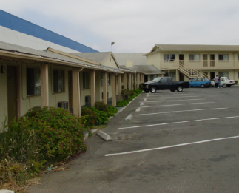
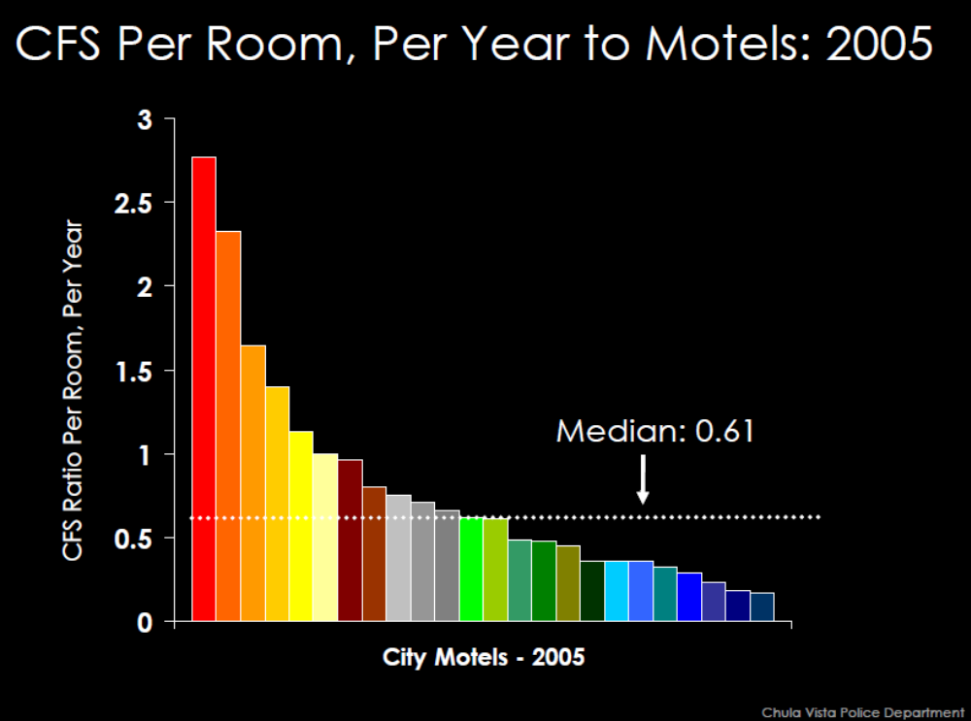
Crime Sites
Repeat addresses – concentrations of crime at particular locations, and the spatial arrangement of these sites.
Risky facilities – the distribution of crime within a set of proprietary places.
Sources:
Clarke & Eck, 2007. Understanding Risky Facilities, http://www.popcenter.org/tools/risky_facilities/
Chula Vista Police, 2009. Reducing Crime and Disorder at Motels and Hotels in Chula Vista, California
http://www.popcenter.org/library/awards/goldstein/2009/09-47%28W%29.pdf
Notes:
Repeat addresses are proprietary places with many crimes or disorder events in a time period. They maybe centers of hotspots. If we look at all proprietary places of a single type, a few will be repeat addresses. In this example, the photo shows a Chula Vista hotel that in 2005 was a repeat address. The graph at the bottom is a risky facility chart. It shows all motels in Chula Vista in 2005 and ranks them by calls for service per room (to adjust for size). So a crime site can be looked at in isolation (as a repeat address) or in the context of similar places (risky facility analysis).

Slide 9
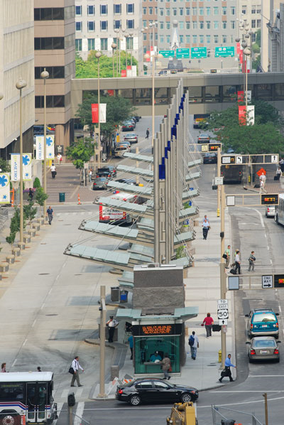
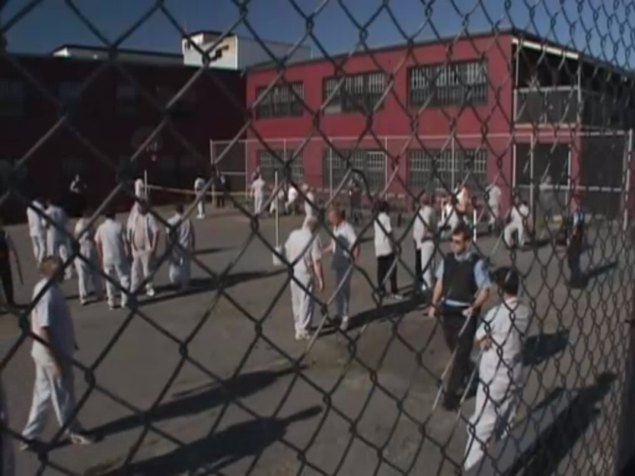
Convergent Settings
Felson (2003) suggested that some situations facilitate the meeting of potential offenders, and this can serve to create and maintain crime groups.
Since meetings among people require small spaces, convergent settings are proprietary or proximal places (but not pooled places).
Transit hub
Correctional institution
Notes:
Transport hubs, entertainment venues, shopping areas, high schools, jails and prisons can serve as convergent settings. Convergent settings, unlike meeting comfort spaces (see next), are usually created to bring people together. Offenders can capitalize on these circumstances.
The left image shows a transit hub in downtown Cincinnati, Government Square. Because public transportation serves school children, juveniles from all over the city come together here at particular times. Police and employees from the transit authority monitor activities at this site.
Correctional institutions can also serve as convergent settings. The right image is a screen shot from the Canadian television crime show, Trailer Park Boys.

Slide 10
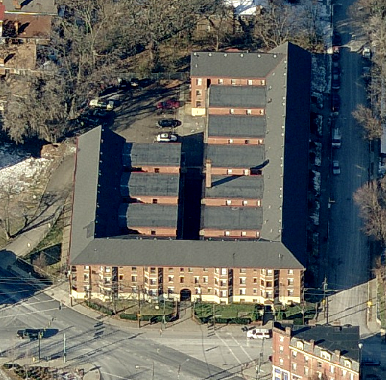
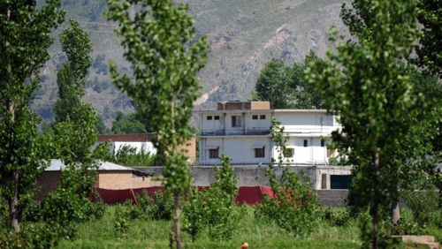
Comfort Spaces
Hammer (2011) claims that offenders use some places to routinely meet, provide recreation, stash tools and goods, and in other ways facilitate crime else where. Offenders may avoid crimes at these locations to protect them from police intervention.
Cincinnati
Abbottabad
Notes:
The apartment building served as a comfort space for many years. Offenders used apartments rented by their girl friends and the parking area to the rear of the building, but for the most part committed their crimes in the surrounding area. The other example requires no explanation.

Slide 11
Forms of Comfort Spaces
Staging -- provide safe haven in close proximity to customers and targets (and offending locations in general). They give an offender a space in which to observe neighborhood activities without great risk of apprehension by police.
Supplying – stash location for supplying black market sites, often in close proximity to crime sites. May also stash goods stolen from crime sites.
Meeting – provides a comfortable private place for offenders to meet and socialize.

Slide 12
General Geography of Comfort Spaces
Supplying
Staging
Meeting
Crime Site & hot spot
Depending on the crime, transport, and local circumstances staging places may have to be closer to crime sites than other comfort spaces, and meeting places can be located further away.
Notes:
This is a general rule, not a hard and fast requirement. Offenders’ access to convenient transportation will be important. Offenders who can travel longer distances may have staging areas further away from crimes than offenders with limited transport. A gang with strong rivals may be constrained where it can have its meeting places, and this might force them to meet close to crime sites. But since staging is closely linked to an immediate crime, it makes sense that it probably needs to be closer to crime sites relative to supply and meeting places. Security and comfort make it advantageous to have meeting and supply places at some distance from crime sites. But as we said, these are rules of thumb, not precise predictions.

Slide 13
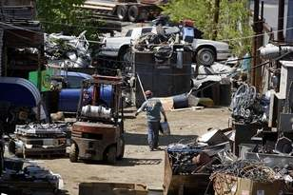
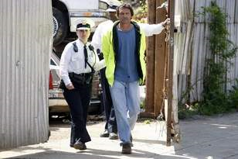
Corrupting Spots
Corrupting spots support transactions that facilitate crime elsewhere. Two examples of corrupting spots for metal theft are shown here. Though crime occurs in these spots, its consensual so is not reported.
Cincinnati -- Cincy Recycling owner being arrested on six charges of failing to keep records.
http://news.cincinnati.com/article/20100419/NEWS010701/4200357/Cincinnati-police-busting-scrap-dealers
Notes:
Corrupting spots may also fail to show on crime maps. Here is an example of a metal recycling facility. Like comfort spaces, intelligence may be required to identify them. But unlike comforts spaces, it may be possible to logically deduce suspected corrupting locations based on the crime process, e.g., all that copper must go somewhere that can handle it.

Slide 14
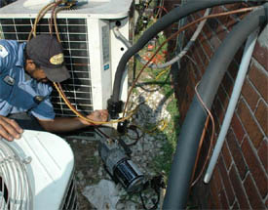
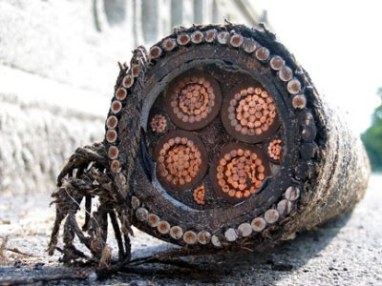
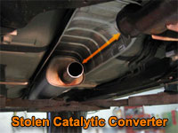
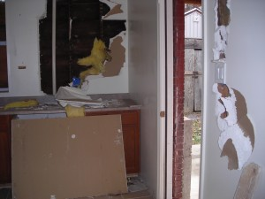
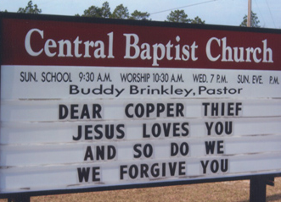
Picture Sources http://www.callthiele.com/news/072208-thiele-introduces-warning-watchdog.htm http://www.businessinsider.com/the-crowd-is-back-into-commodities-copper-theft-is-back-2009-11 http://mareinet.com/2011/01/30/stop-copper-theft-open-letter-to-the-law-makers/ http://www.aikenstandard.com/ http://www.hubbardtwppd.org/Safety%20Tips/catalytic.htm
Crime Places and Copper Theft
Copper condensing
air-conditioning units
Light/telephone poles & power stations
Crime Sites
Vacant/foreclosed properties
Churches

Slide 15
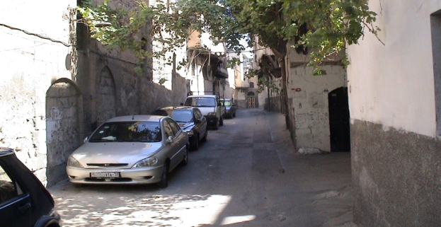
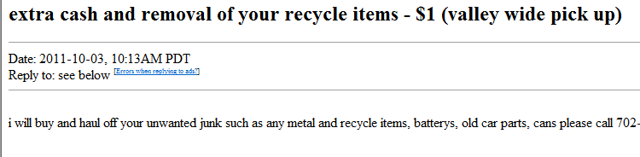
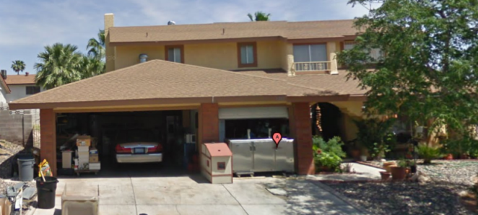

Crime Places and Copper Theft
What we see
What we don’t see
Comfort Space
Corrupting Spot
Crime Sites
Staging location
where offenders park & meet close to crime sites
Recycling Plant
Convergent Setting
Comfort Space
Supplying location
where metal is stored
Notes:
15

Slide 16
Proprietary Places have Different Roles in Crime Processes
 | Long Before | Just Before | During | After
Convergent Setting | X | X | X | X
Comfort Space | X | X |  | X
Meeting | X | X |  | X
Supplying | X | X |  | X
Staging |  | X
Corrupting Spot | X |  |  | X
Crime Site |  |  | X
If we focus solely on crime sites, we ignore other stages of the crime process.

